Slide 1
TaiMed Biologics, Inc.
May 24, 2018

Slide 2
Corporate Structure
TaiMed Biologics, Inc. in Taipei, Taiwan
Corporate Headquarter/Administration
Finance/Accounting
Research & Development（GMP Analytical Lab）
TaiMed Biologics, HsinChu Branch, Taiwan
Manufacturing Operations
QA/QC
Supply chain Management
TaiMed Biologics USA in Irvine, CA, USA
Clinical
Business Development
中裕新藥

Slide 3
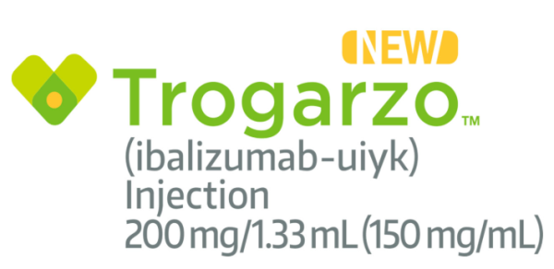
Milestones
Ibalizumab (TMB-355)
HIV new drug Trogarzo is now available in the U.S.–4/30/2018
The FDA granted approval of Trogarzo (trade name for ibalizumab) to TaiMed Biologics - 3/6/2018 (US time)
Completed Phase III trial – 11/2016 (US, TW)
Granted US FDA breakthrough designation therapy for MDR patients in IV dosage form – 2/2015
Granted US FDA orphan drug designation for MDR patients – 10/2014
Completed Phase II b -2011 (US, TW)

Slide 4
2018 Target for Operations
Preparing the Trogarzo submission for regulatory approval in Europe –Q3/2018
FDA decision on IM/IV push proposal- 6/2018
Phase I start of TMB-365–Q3/2018
Phase I start of Bi-specific - Q4/2018
Complete phase 1 of TMB-607 end of 2018 (Cohort recently completed. DSMB met with no issues to proceed)

Slide 5
Trogarzo US Addressable Market*
US HIV infected population 1.4 million
US MDR HIV population
20 – 25 K
US HIV treated population 450 – 650 K
population requiring new treatment
10 – 12 K
*EU patient population is of similar size

Slide 6
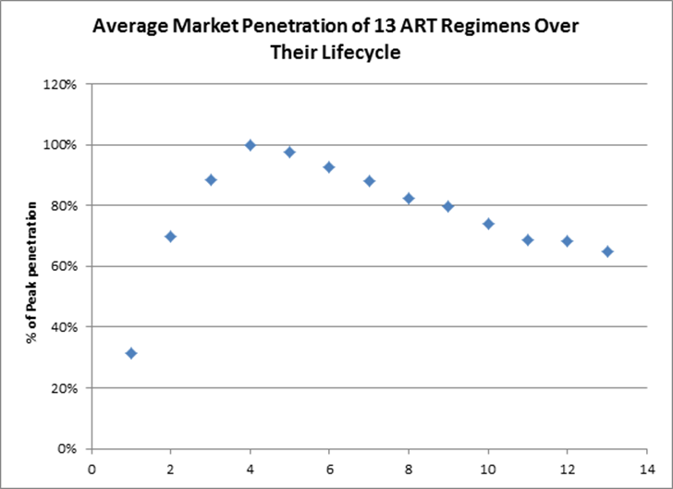
Research for Market Trend
Expecting to complete the private and public insurance coverage in 2018
Progressing well for the product launch
We believe Trogarzo could mimic other successful HIV product launches
Years post-launch

Slide 7
Theratechnologies Partnership
 | North American Agreement | European Agreement
Date of agreement | March 18, 2016 | March 6, 2017
Term | 12 years from FDA approval | 12 years from approval (country-by-country basis)
Transfer Price | 52% of Net Sales | 52% (57% of annual sales exceeding US$50M in European Territory
Payment at signature | US$1M (cash) | US$3M (common shares)
Upfront and launch milestone | US$4M (common shares) US$5.5M (cash – payable through an increase in transfer price) | US$5M (cash – payable one year after launch) US$5M (cash – payable once EU sales reach US$50M)
Development milestones | US$3M (Intramuscular administration approval) | 50% of European clinical trial costs (if any)
Commercial milestones | Up to US$207M upon reaching various sales levels (up to US$1B) and label expansion objectives | Up to US$80M upon reaching various sales levels (up to US$1B)

Slide 8
Accounting Treatment for Theratechnologies contract
 | IFRS 15“Revenue from Contracts with Customers” | IAS 18 “Revenue”
Effective Date | From January 1, 2018 | Before December 31, 2107
Transfer Price | 52% of Net Sales at the completion time of sales | 52% of Net Sales at the completion time of sales
Valuation on shares received | Thera shares are measured at fair market value. The changes in the carrying amount of shares are recognized in non-operating income | Thera shares are measured at fair market value. The changes in the carrying amount of shares are recognized in other comprehensive income
Cash and shares upfront and launch milestone（including US$5.5M milestone） | Recording as liability-“performance obligation” at the time of upfront received or milestone achieved . Recognizing revenue based on expected sales volume-based method at the drug launch time or development milestone achieved. | The upfront payments and development milestone payments are recognized according to the degree of performance over the estimated performance period stipulated in the agreement on a straight-line basis;
Development milestones
Commercial milestones | Evaluate, on an on-going basis, each milestone in the contract to determine whether including an estimate of variable consideration in the transaction price at the drug launch time, using the most likely amount method. | the commercial milestone payments are recognized as revenue when the commercial milestones are achieved and the revenue is not expected to be reversed.
Adjustment for amrotization | Estimate adjustment if significant change in expected sales volume. | straight-line based amortization except for amendment of contract periods.
Note: the above accounting treatment is only suitable TaiMed.

Slide 9
TaiMed Biologics Inc.
(In Thousands of New Taiwan Dollars, Except Earning Per Share)
 | 2018 Q1 | 2017 Q1
OPERATING REVENUE | 0 | 1,217
OPERATING COSTS | 6,934 | 0
GROSS PROFIT | (6,934) | 1,217
OPERATING EXPENSES
General and administrative expenses | (10,760) | (9,736)
Research and development expenses | (76,659) | (61,781)
Total operating expenses | (87,419) | (71,517)
OTHER OPERATING INCOME (note) | 182,090 | 0
INCOME FROM OPERATIONS | 87,737 | (70,300)
NON-OPERATING INCOME AND EXPENSES | 39,524 | (10,913)
INCOME BEFORE INCOME TAX | 127,261 | (81,213)
INCOME AFTER INCOME TAX | 127,261 | (81,213)
EARNING PER SHARE (EPS) | 0.51 | (0.32)
note：Gain on inventory recovery for net realizable value due for TMB-355(Trogarzo) approved by US FDA on March 6, 2108.

Slide 10
Taimed Biologics Zhubei
(Manufacturing Operations)
May 24, 2018

Slide 11
Taimed Biologics Zhubei
cGMP Biologics Manufacturing Facility
Process Development and Manufacturing
QC Release and Quality Assurance
Global Supply Chain Management
3rd Party Contract Manufacturer Management

Slide 12
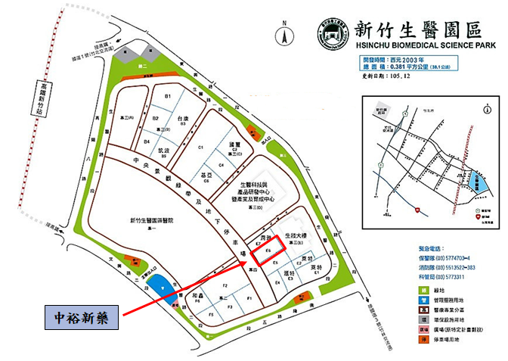
Facility Location

Slide 13
Facility Overview
State-of-the-Art Five Story Building with ~5500 m²（Production Area is 1142 m²)
1F: Warehouse
2F:
QC and Microbiology Labs – Routine release and stability testing, environmental monitoring
Process development Lab – Process development & characterization, scale-up and optimization
3F: Biologics production area
4F: Cold chain storage of intermediates, drug substance and finished goods

Slide 14
Facility Design Principles
Maintain equipment “sameness” between Zhubei facility and Wuxi Biologics to ensure high level of product comparability
Use of single-use technology to maximize manufacturing efficiency and minimize product contamination risks
One 500L and four 2000L single-use bioreactors (SUB) to maintain manufacturing flexibility to produce both commercial and clinical batches
Full production capacity is 48 batches @ 4000L scale

Slide 15
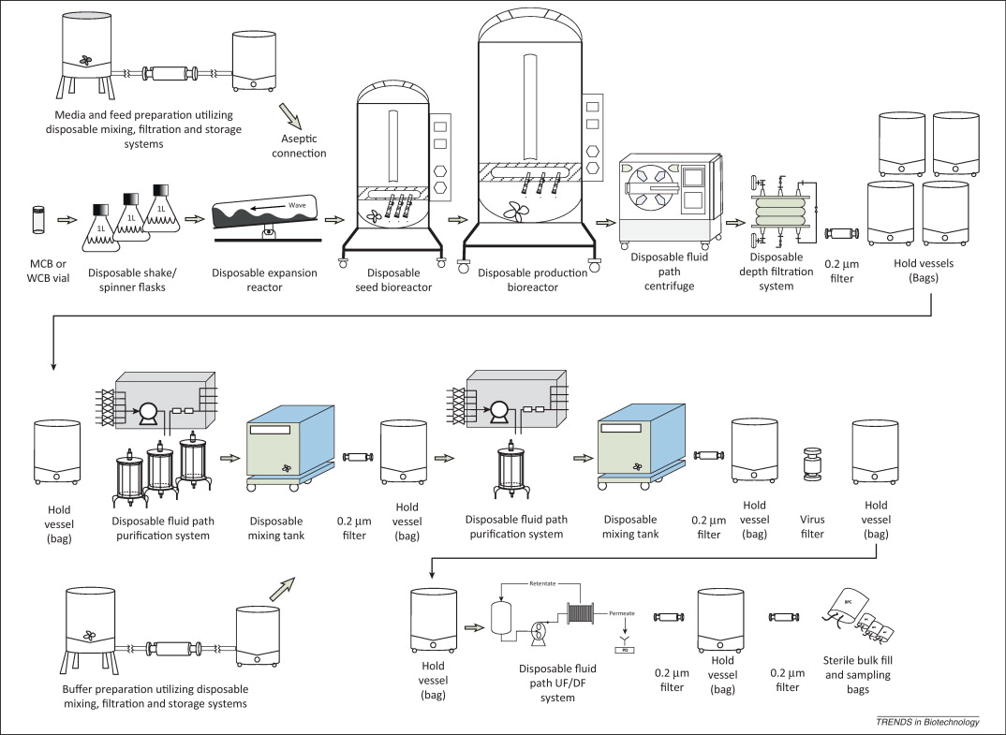
Biologics Manufacturing Process
Source: Trends in Biotechnology, Volume 31, Issue 3, p147–154, March 2013

Slide 16
Firms and Vendors
cGMP Facility Design:
Facility design with Nova Pharma Solutions (Malaysia) and BPTC (USA)
Facility Construction:
Ruentex Engineering & Const.Co (潤弘精密公司) – Building design and construction
China Ecotek (中宇環保) – Facility & utility engineering, cleanroom
Production Equipment:
Alfa Laval, Merck, Sartorius, ThermoFisher, etc.

Slide 17
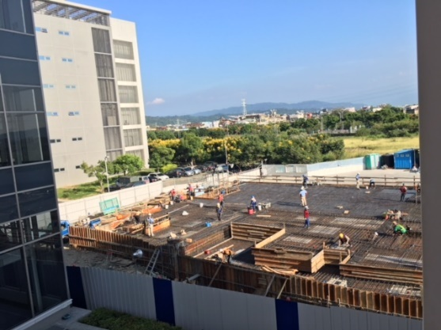
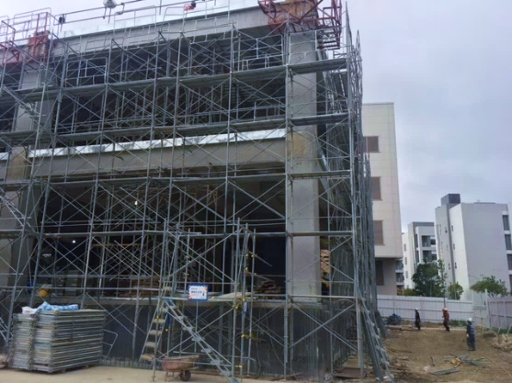
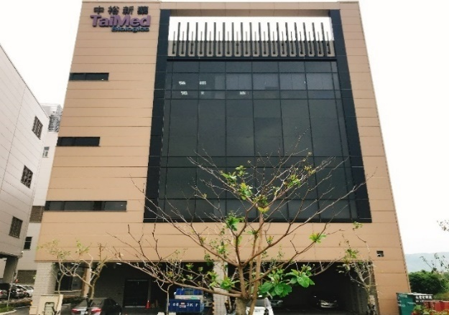
Timeline
Ground-breaking ceremony – June 2017
Topping-out ceremony – Nov 2017
Obtained building use license – Feb 2018
Initiated facility utility engineering and interior construction project – Mar 2018
Target facility completion – Sept 2018
Total Investment NT$1B
9/2017
10/2017
4/2018

Slide 18
Timeline
Equipment IOQ
3Q2018–1Q2019
PD/Tech Transfer from Wuxi
3Q2018–2Q2019
3 PPQ Batches
2H/2019
12 Months Stability Data
FDA Inspection
3Q2019-4Q2020
Commercial Production

Slide 19
Organization Chart
CTO
Admin
Facility & Engineering
Manufacturing & Technology
Quality Assurance
Quality Controls
Supply Chain Mgmt
Engineering
Facility Maint
Manufacturing
Mfg Support
Audit & Inspection
QMS & Documentation
Analytical
Microbiology and EM
Procurement
Material Mgmt
Vendor Mgmt
Consultant
Consultant
Consultant
Contractors
Product Release and Review
EHS
Project Mgmt

Slide 20
Trogarzo Supply Chain (US Market)
Labeling and Packaging
Allentown, PA
2
DS and DP Mfg
Wuxi, China
1
Distribution
Louisville, KY
3
Notes:
Mention AMRI and Irvine

Slide 21
Thank You
Q & A

